Slide 1
Network and Cyber Security-I (CY2001) (Lecture 14 and 15)
Dr. Qaisar Shafi
Department of Computer Science,
National University of Computer & Emerging Sciences, Islamabad Campus

Slide 2
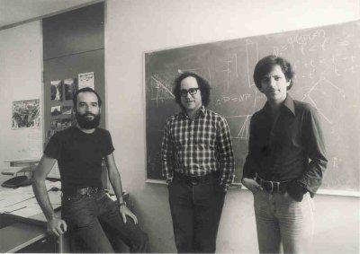
RSA (Rivest Shamir Adleman)
-1978
In 2002, the Association for Computing Machinery awarded Rivest, Shamir, and Adleman the Turing Award - also known as the "Nobel Prize of Computing."
Notes:
In 2002, the Association for Computing Machinery awarded Rivest, Shamir, and Adleman the Turing Award - also known as the "Nobel Prize of Computing."

Slide 3
Asymmetric Encryption
Asymmetric encryption is the form of cryptosystem in which encryption and decryption are performed using the different keys- one a public key and other a private key, known as public key encryption.
Public key algorithms are based on mathematical function rather than on substitution and permutation.

Slide 4
Principles of public key cryptosystems
Evolved from two problems associated with symmetric encryption.
First is that of key distribution.
Second problem was use of digital signatures.

Slide 5
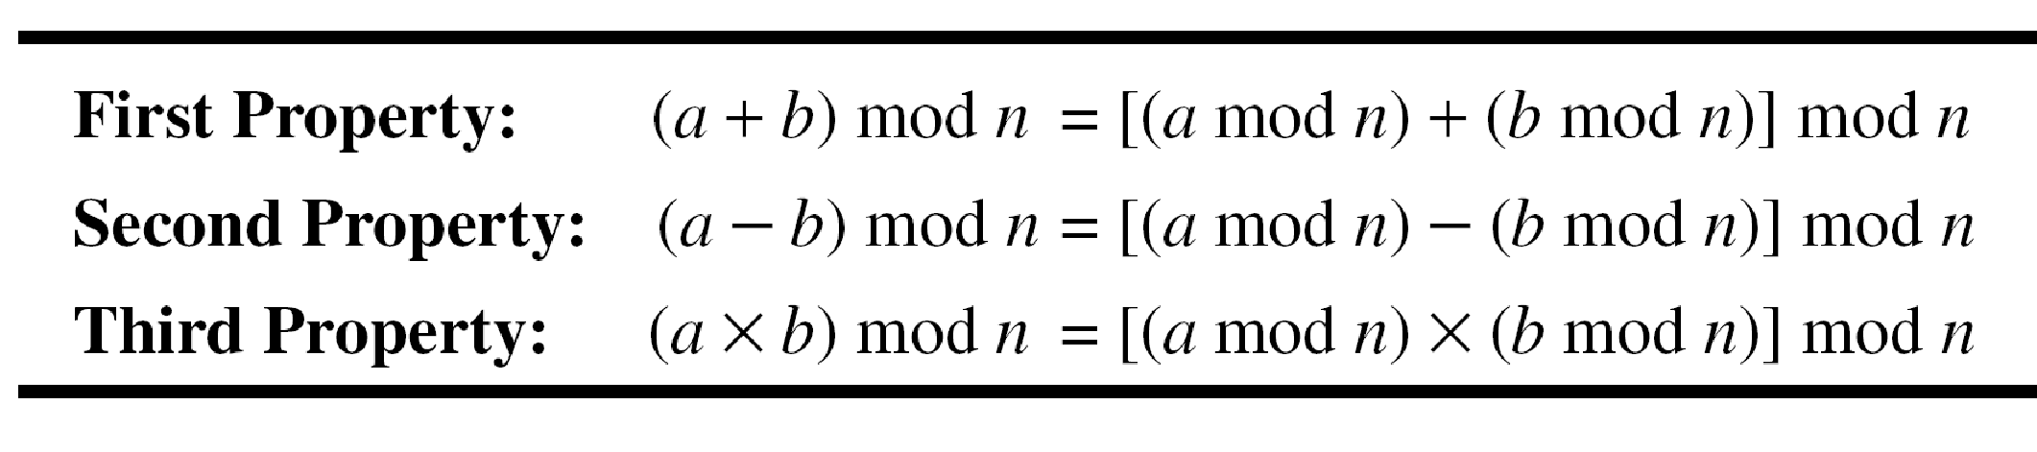
Modulus Operations
Add 17 to 27 in Z₁₄
Subtract 43 from 12 in Z₁₃
Multiply 123 by −10 in Z₁₉
14+7 mod 15
7-11 mod 13
7 x 11 mod 20
5
Notes:
5
Mod with negative numbers:
Dividing −18 by 14 results in r = −4. After adding the modulus r = 10
Dividing −7 by 10 results in r = −7. After adding the modulus to −7, r = 3
Exercise
-8 mod 10
-7 mod 13
-13 mod 5
-18 mod 14

Slide 6


Inverses
In Z_{n}, two numbers a and b are additive inverses of each other if
In Z_{n}, two numbers a and b are mutliplicative inverses of each other if
Find additive inverse
4 mod 13
7 mod 17
Find multiplicative inverse
3 mod 5
2 mod 7
6
Notes:
6

Slide 7
Inverses
Find all multiplicative inverse pairs in Z₁₁.
We have six pairs:
(1, 1)
(2, 6)
(3, 4)
(5, 9)
(7, 8)
(10, 10)
Note 11 is prime so every number from 0 to n-1 has a multiplicative inverse
7
Notes:
7

Slide 8
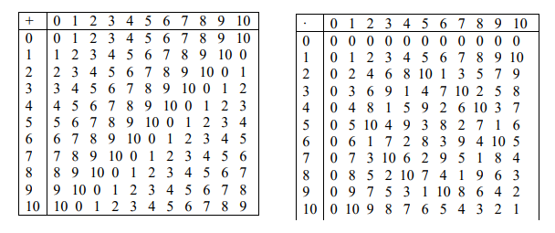
Inverses
8
Notes:
8

Slide 9
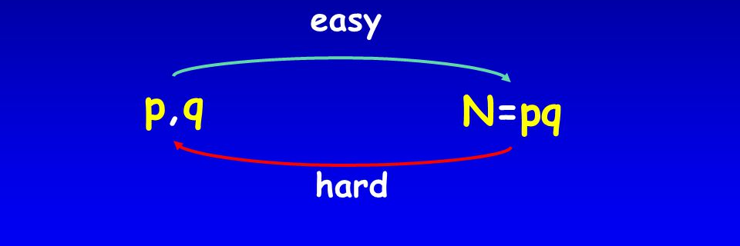
Trapdoor Function
a trapdoor function is a function that is easy to compute in one direction, yet difficult to compute in the opposite direction (finding its inverse) without special information, called the "trapdoor"
factoring product of 2 large primes is a hard problem.

Slide 10
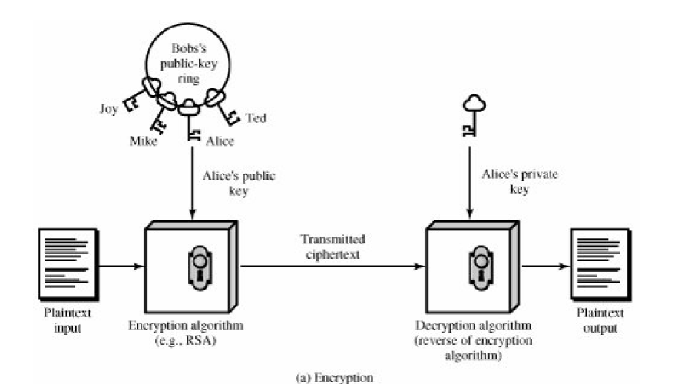
Public key Cryptosystem (Encryption)

Slide 11
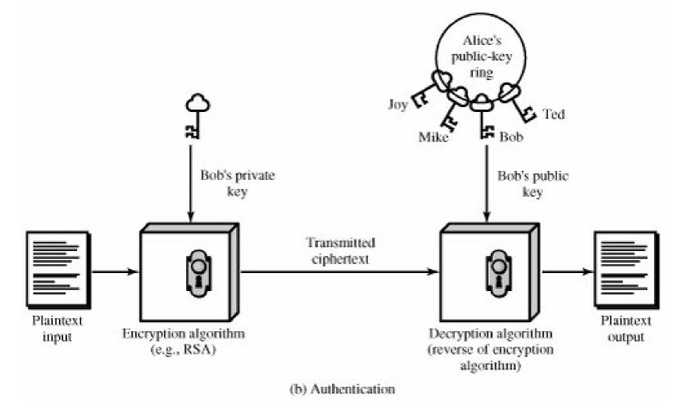
Public Key Cryptosystem (Authentication)

Slide 12
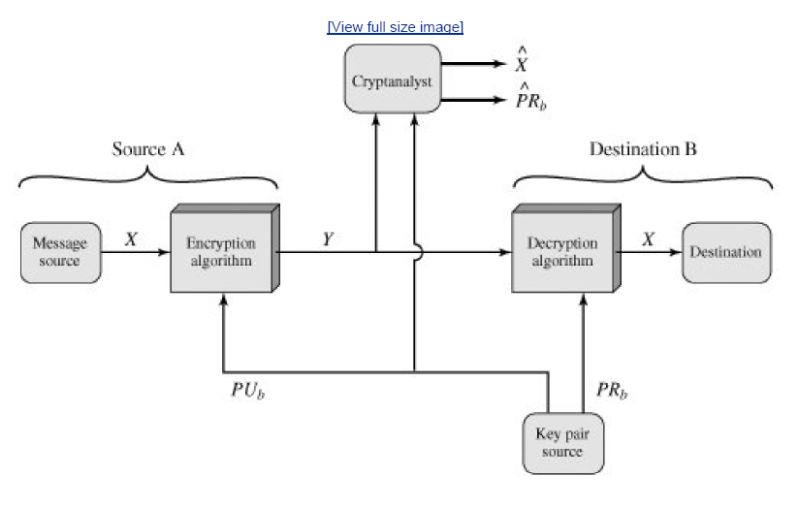
Public key Cryptosystem: (Secrecy)

Slide 13
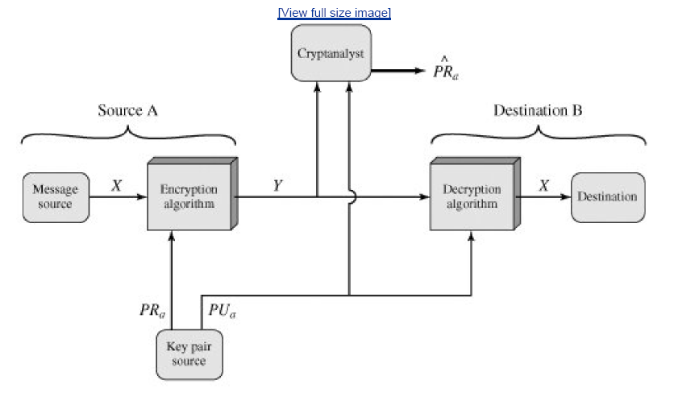
Public key Cryptosystem: (Authentication)

Slide 14
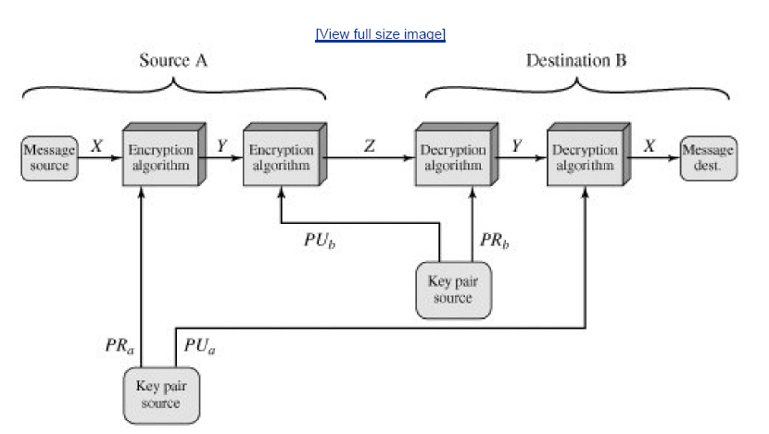
Public Key Cryptosystem (Authentication & Secrecy)

Slide 15
Applications for Public key Cryptosystems
Encryption/decryption: the sender encrypts a message with the recipient's public key.
Digital Signature: the sender “signs” a message with its private key. Signing is achieved by a cryptographic algorithm applied to the message or to a small block of data that is the function of the message.
Key exchange: two sides cooperate to exchange a session key. Several different approaches are possible.

Slide 16
Requirements for Public-key Cryptography
It is computationally easy for a party B to generate a pair(Public key PUb , private key PRb )
It is computationally easy for a sender A, knowing the public key and the message to be encrypted, M, to generate the corresponding ciphertext.
C = E(PUb , M)
It is computationally easy for the receiver B to decrypt the resulting cipherext using the private key to recover the original message.
M = D(PR b , C) = D[PR b, E(PU b , M)
It is computationally infeasible for an adversary , knowing the public key, PUb , to determine the private key , PRb.
It is computationally infeasible for an adversary, knowing the public key , PUb, and the ciphertext , C , to recover the original message M.

Slide 17
Rivest-Shamir-Adleman (RSA)
Each person that wants to be able to receive encrypted messages must generate a RSA key pair
The RSA key pair is comprised of a public key (that is shared with the sender and anyone else that may want to send encrypted messages to the receiver) and a private key (that is kept secret by the receiver)
The public key is used by the sender to encrypt messages to the receiver
The private key is used by the receiver to decrypt messages
The RSA key generation algorithm generates a public key and a secret key (RSA key pair)

Slide 18
RSA Key Generation
Bob wants to generate an RSA key pair so that his friends can send him encrypted messages over an insecure channel
He chooses two large prime numbers p and q and calculates their product n = pq
He chooses a number e that has no common factors with (p-1)(q-1)
The public key is the pair of numbers (e, n)
Bob calculates:
d = e⁻¹ (mod (p-1)(q-1))
d is called the multiplicative inverse of e mod (p-1)(q-1) and is calculated using Euclid’s extended gcd algorithm
Bob’s private key is the pair of numbers (d, n)

Slide 19
RSA Encryption
Alice wants to securely send a message to Bob over an insecure channel
Bob gives his public key (e, n) to Alice
Alice splits the plaintext message into blocks so that each block can be represented as a number that is less than the number n
Suppose that one such block is m
Alice calculates the ciphertext: c = m^{e} (mod n)
and sends c to Bob
Bob decrypts the ciphertext block c using his private key (d, n) by calculating:
m = c^{d} (mod n)
Thus he receives the original message block m

Slide 20
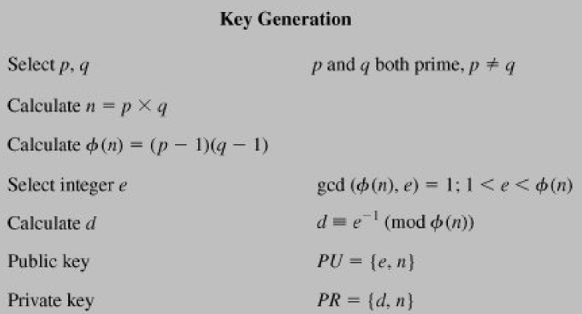
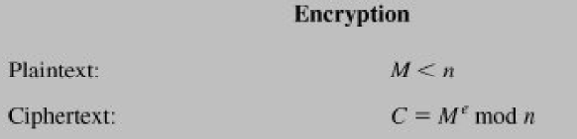
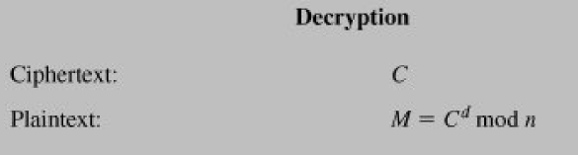

Slide 21
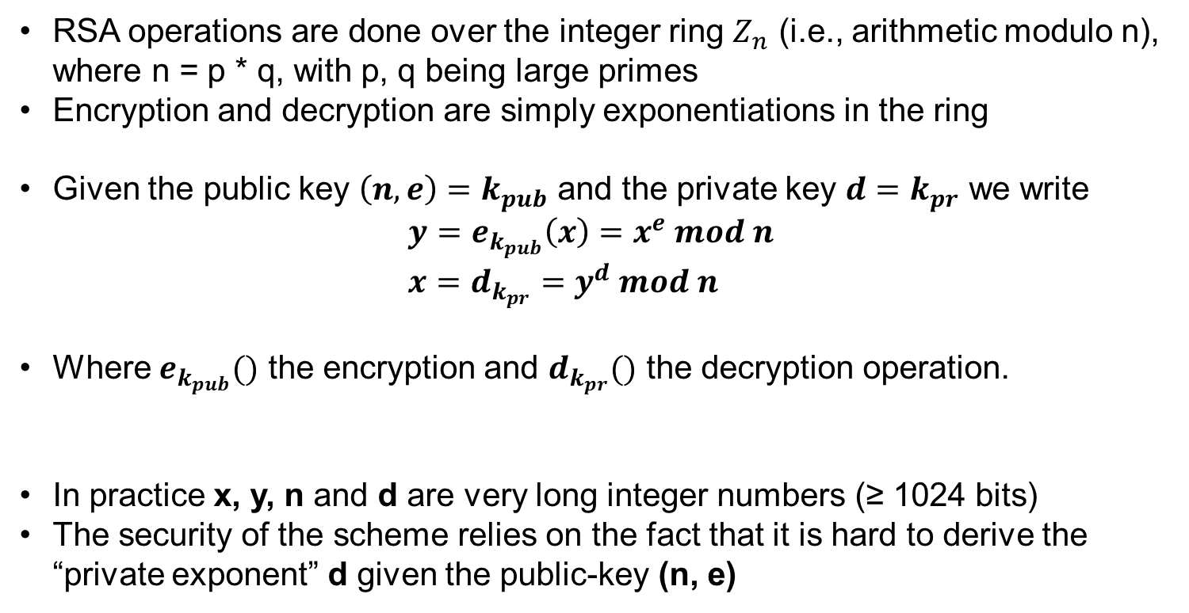
RSA Algorithm
RSA operations are done over the integer ring $Z_{n}$ (i.e., arithmetic modulo n), where n = p * q, with p, q being large primes
Encryption and decryption are simply exponentiations in the ring
Given the public key $\left(n,e\right)=k_{pub}$ and the private key $d=k_{pr}$ we write
$$y=e_{k_{pub}}\left(x\right)=x^{e} mod n \\ x=d_{k_{pr}}=y^{d} mod n$$
Where $e_{k_{pub}}()$ the encryption and $d_{k_{pr}}()$ the decryption operation.
In practice x, y, n and d are very long integer numbers (≥ 1024 bits)
The security of the scheme relies on the fact that it is hard to derive the “private exponent” d given the public-key (n, e)
Notes:
Rivest-Shamir-Adleman

Slide 22
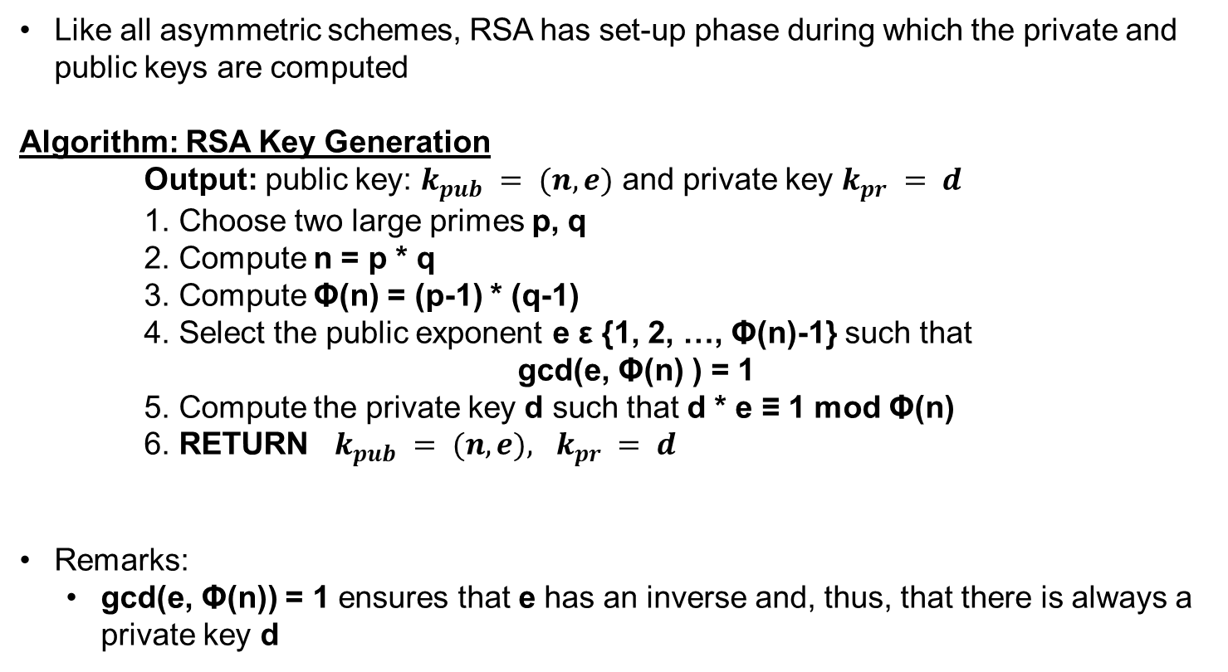
RSA Key Generation
Like all asymmetric schemes, RSA has set-up phase during which the private and public keys are computed
Algorithm: RSA Key Generation
Output: public key: $k_{pub} = (n, e)$ and private key $k_{pr} = d$
1. Choose two large primes p, q
2. Compute n = p * q
3. Compute Φ(n) = (p-1) * (q-1)
4. Select the public exponent e ε {1, 2, …, Φ(n)-1} such that
gcd(e, Φ(n) ) = 1
5. Compute the private key d such that d * e ≡ 1 mod Φ(n)
6. RETURN $k_{pub} = (n, e), k_{pr} = d$
Remarks:
gcd(e, Φ(n)) = 1 ensures that e has an inverse and, thus, that there is always a private key d

Slide 23
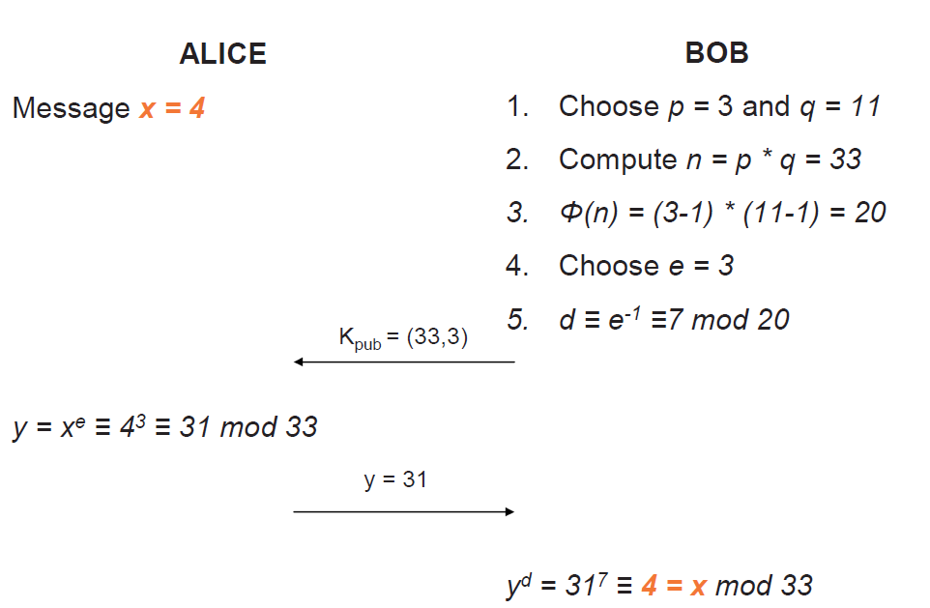
RSA Example

Slide 24
Mathematical algorithms
The following algorithms are needed to implement RSA:
Primality test (to verify that the integers p and q that are chosen in key generation are prime)
Euclid’s extended algorithm for computing modular inverses (to efficiently find the exponent d from the exponent e)
Modular multiplication and exponentiation (for encryption or decryption)

Slide 25
Fermat primality test
This algorithm uses a well-known theorem in mathematics (called Fermat’s little theorem) to check whether a number is probably prime
Fermat’s little theorem: If p is prime, then a^{p–1} = 1 (mod p)
Fermat primality test algorithm:
Input: integer N that we want to test for primality
Choose a random number A in the range 1 to N-1
If A^{N–1} ≠ 1 (mod N) then N is definitely not prime
Repeat this test for different values of A
To perform the Fermat primality test on large integers, you should use a fast modular exponentiation algorithm (such as the square-and-multiply algorithm)
Notes:
Carmichael numbers = 561, 1105, 1729, 2465, 2821, 6601, 8911, 10585, 15841, 29341, 41041, 46657, 52633, 62745, 63973, and 75361
https://www.dcode.fr/primality-test
https://crypto.stanford.edu/pbc/notes/numbertheory/millerrabin.html#:~:text=By%20Fermat%E2%80%99s%20Theorem%2C%20if%20n%20is%20prime%2C%20then,%3D%20561%20%3D%203%20%C3%97%2011%20%C3%97%2017.
The Miller-Rabin Test

Slide 26
Euclid’s extended algorithm
To find the private key exponent d we need to calculate d = e^{–1} (mod (p–1)(q–1))
A quick way to do this is by using Euclid’s extended algorithm for modular inverses:
Label five columns: a, n, q, u, v
Let a = the number whose multiplicative inverse we wish to find
Let n = the modulus
Let u = 1 and v = 0
Let q = a/n (zero in first step, if a < n)
The next step:
Let a = n and n = a – nq
Let u = v and v = u – vq
Let q = a/n
If n ≠ 1 then repeat above step
The result (multiplicative inverse of a mod n) is v
If v < 0 then we can make v a positive integer in the range 0 to (n–1) by adding n
For this algorithm to work, gcd(a,n) = 1 (i.e., a and n must have no common factors)

Slide 27
Example: Euclid’s extended algorithm
Suppose we want to find the multiplicative inverse of 17 mod 616
Euclid’s extended algorithm:
a n q u v
17 616 0 1 0
616 17 36 0 1
17 4 4 1 -36
4 1 4 -36 145
Result: 145
Verify: 17 x 145 = 1 (mod 616)
Notes:
Note that 616 = (23–1)(29–1)

Slide 28
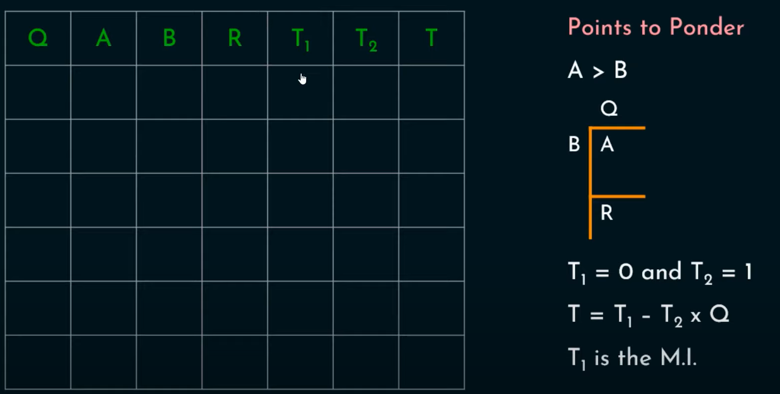
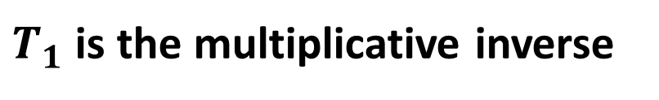
Euclid’s extended algorithm
$T_{1}$is the multiplicative inverse
Notes:
Note that 616 = (23–1)(29–1)

Slide 29
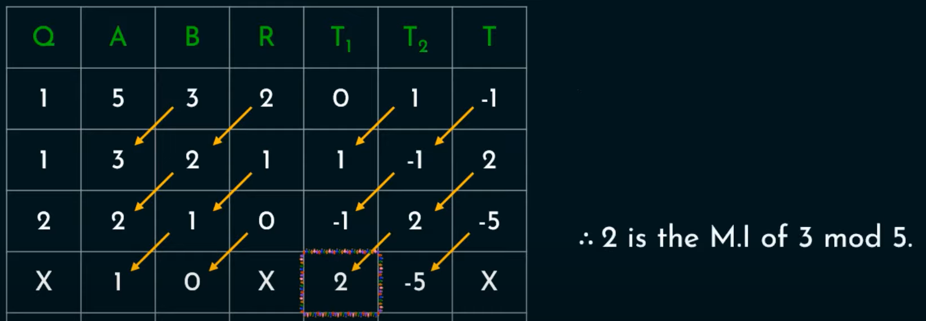
Euclid’s extended algorithm
Example: 3 mod 5
Notes:
Note that 616 = (23–1)(29–1)

Slide 30
Notes:
Note that 616 = (23–1)(29–1)

Slide 31
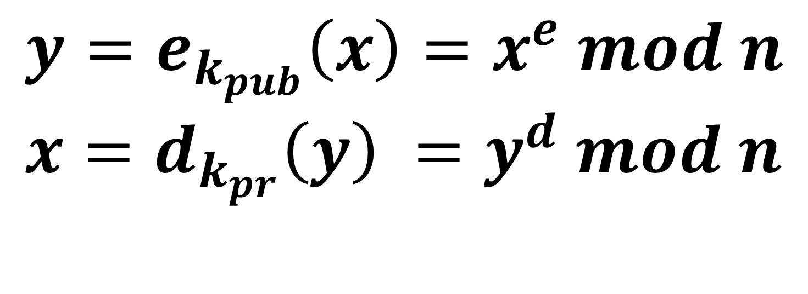
RSA Algorithm
$$y=e_{k_{pub}}\left(x\right)=x^{e} mod n \\ x=d_{k_{pr}}\left(y\right) =y^{d} mod n$$
Notes:
Rivest-Shamir-Adleman

Slide 32
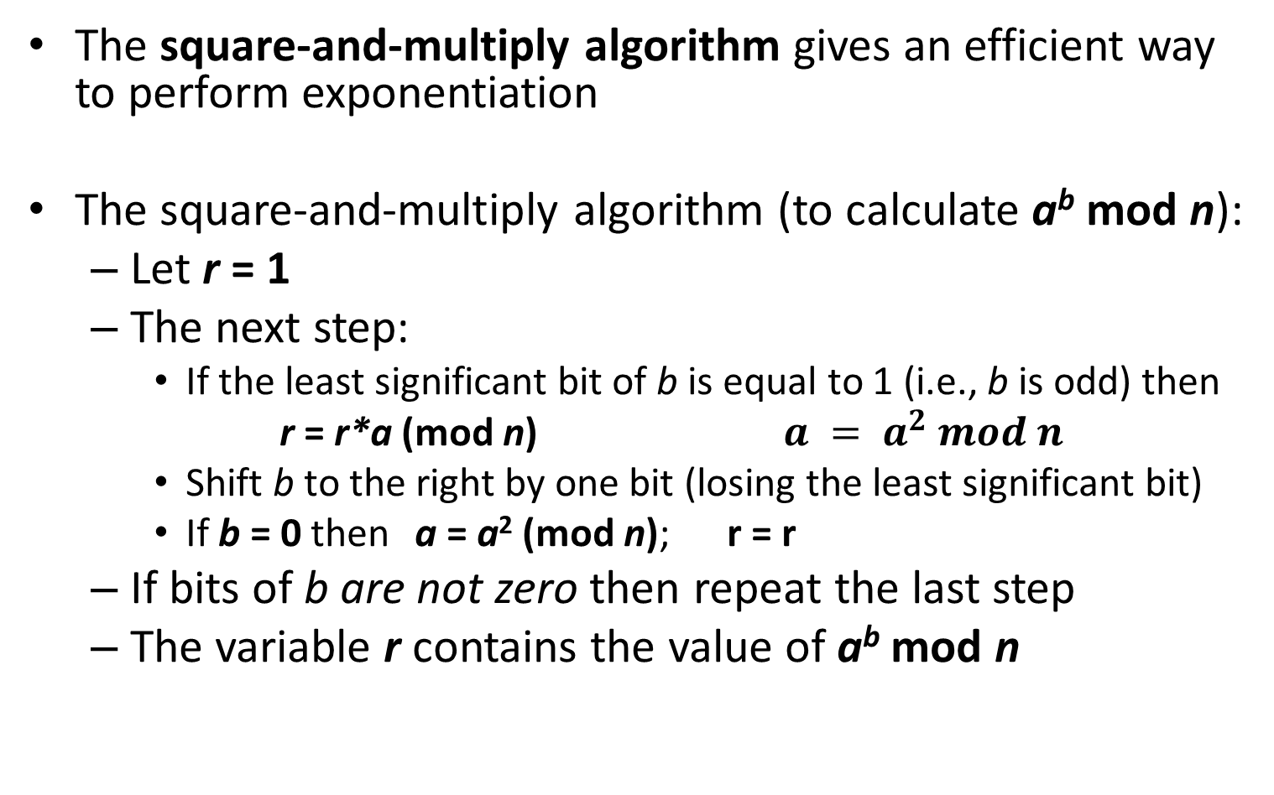
Square-and-multiply algorithm
The square-and-multiply algorithm gives an efficient way to perform exponentiation
The square-and-multiply algorithm (to calculate a^{b} mod n):
Let r = 1
The next step:
If the least significant bit of b is equal to 1 (i.e., b is odd) then
r = r*a (mod n) $a = a^{2} mod n$
Shift b to the right by one bit (losing the least significant bit)
If b = 0 then a = a² (mod n); r = r
If bits of b are not zero then repeat the last step
The variable r contains the value of a^{b} mod n
Notes:
If b = 1
r’ = r*a mod n
a’ = a^2 mod n
If b = 0
r’ = r
a’ = a^2 mod n

Slide 33
Example: Square-and-multiply algorithm
Suppose we want to find the value of (123)¹⁷ mod 667
The square-and-multiply algorithm:
r a b
1 123 17 (10001)
123 455 8 (1000)
123 255 4 (100)
123 326 2 (10)
123 223 1 (1)
82 - 0
Result: (123)¹⁷ mod 667 = 82
Notes:
Note that 667 = 23 x 29
If b = 1
r’ = r*a mod n
a’ = a^2 mod n
If b = 0
r’ = r
a’ = a^2 mod n

Slide 34
Example: Square-and-multiply algorithm
Suppose we want to find the value of (82)¹⁴⁵ mod 667
The square-and-multiply algorithm:
r a b
1 82 145 (10010001)
82 54 72 (1001000)
82 248 36 (100100)
82 140 18 (10010)
82 257 9 (1001)
397 16 4 (100)
397 256 2 (10)
397 170 1 (1)
123 - 0
Result: (82)¹⁴⁵ mod 667 = 123
Notes:
If b = 1
r’ = r*a mod n
a’ = a^2 mod n
If b = 0
r’ = r
a’ = a^2 mod n

Slide 35
Fast Exponentiation
a = bc mod n = (b mod n).(c mod n) mod n
Note that any number can be expressed as a sum of powers of 2.
C = 13⁷ mod 33
= 13⁽⁴⁺²⁺¹⁾ mod 33
= 13⁴.13².13¹ mod 33
= 16 .4 . 13 mod 33
= 7 mod 33
13² = 169 ≡ 4 , 13⁴ = 4.4 = 16, 13⁸ = 16.16 = 256 ≡ 25
35
Notes:
35

Slide 36
Digital Signatures
Digital signatures provide a way for a sender to securely ‘sign’ a message so that the recipients of the message can verify that the message originated from the sender (i.e., it is not a forged message)
The RSA scheme can also be used for digital signatures by exploiting the fact that only the sender knows the private key (used for signing) but that everyone knows the sender’s public key (used for verification)

Slide 37
RSA Digital Signatures
Eve has been sending fake emails to Bob pretending to be Alice (impersonation); Bob has no way of telling which emails he has received from Alice are actually from Alice and which ones are from Eve
Alice wants to sign an email message m to Bob so that Bob knows that the email is actually from her
Alice signs the message using her private key (d, n) by calculating: s = m^{d} (mod n)
and sends the signed message s to Bob
Bob obtains Alice’s public key (e, n) from her website or some other source that he can trust
Bob verifies the signature and obtains the original message m using Alice’s public key (e, n):
m = s^{e} (mod n)
Because Alice is the only person that knows d, he can be assured that the message originated from Alice

Slide 38
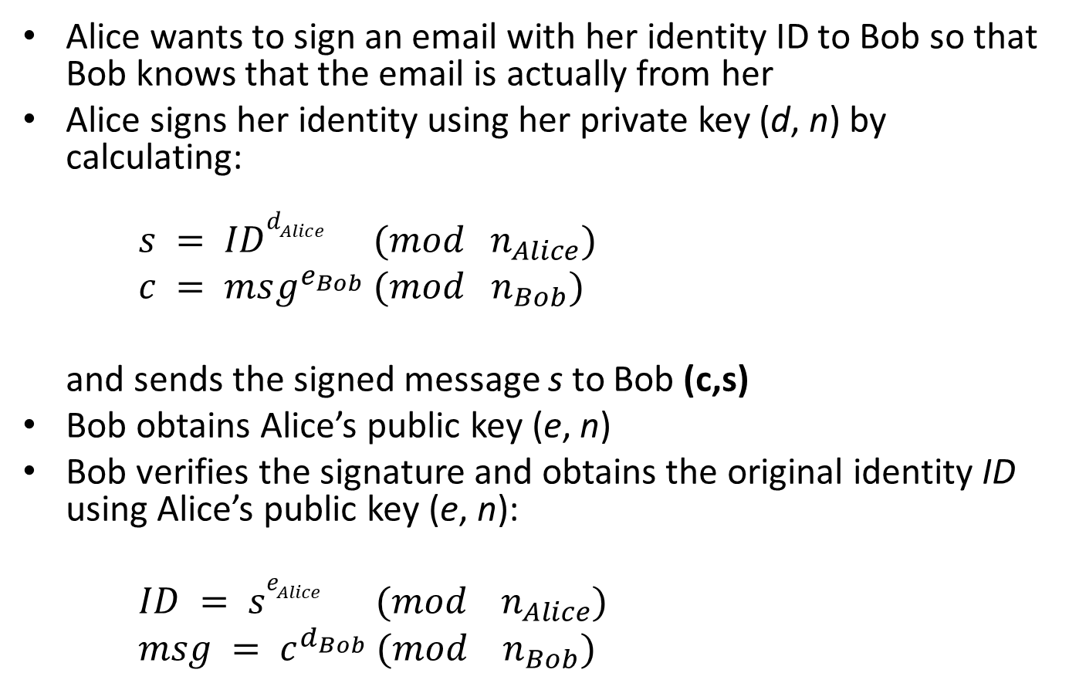
RSA Digital Signatures
Alice wants to sign an email with her identity ID to Bob so that Bob knows that the email is actually from her
Alice signs her identity using her private key (d, n) by calculating:
$s = IDd_{Alice} (mod n_{Alice})$
$c = msg^{e_{Bob}} (mod n_{Bob})$
and sends the signed message s to Bob (c,s)
Bob obtains Alice’s public key (e, n)
Bob verifies the signature and obtains the original identity ID using Alice’s public key (e, n):
$ID = se_{Alice} (mod n_{Alice})$
$msg = c^{d_{Bob}} (mo{d n}_{Bob})$

Slide 39
Encryption and Decryption
Encryption: Plaintext M<n
Ciphertext C= Me(mod n)
Decryption: D= (Me)^{d} mod n
= Mde mod n = M mod n
As d and e are inverse to each other so we get M
p=3, q=11, n=33
M = 2
C = 2⁷ % 33 = 29
D = 29³ % 33 = 2

Slide 40
Key Generation
Choose prime numbers p,q
n=p*q;
Euler’s Totient, φ(n) = (p-1)(q-1)
Choose e such that 1 < e < φ(n) and e and φ (n) are coprime.
Euler’s Theorem, d*e = 1 mod φ(n)
Public key is (e, n)
Private key is (d, n)=(d,p,q)
Choose p = 3 and q = 11
n = 3 * 11 = 33
φ(n) = 2 * 10 = 20
Let e = 7
[(3 * 7) % 20 = 1]
Public key =(7, 33)
Private key = (3, 33)

Slide 41
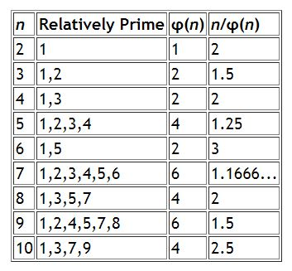
Euler’s Totient Function
Euler’s Totient φ(p) = (p-1)
Euler’s Totient φ(q) = (q-1)
where p and q are both prime
Euler’s Totient φ(n) = (p-1)(q-1)
In number theory, Euler's totient function counts the positive integers up to a given integer n that are relatively prime to n. Also called Euler's phi function.
Notes:
In number theory, Euler's totient function counts the positive integers up to a given integer n that are relatively prime to n. Also called Euler's phi function.

Slide 42
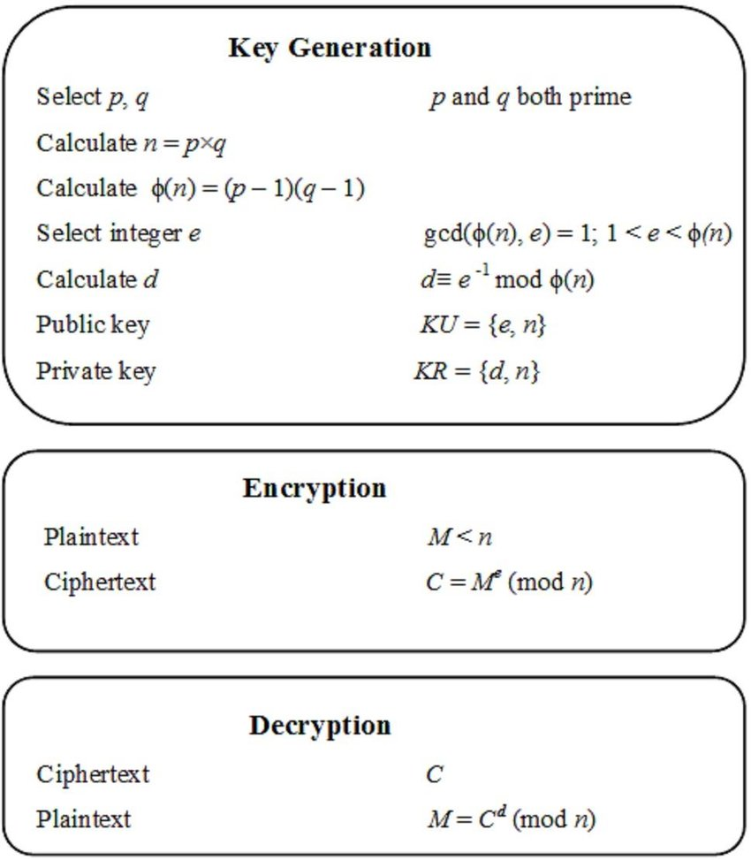
So Far
Simplifications so far:
Message
Calculating d
Encryption/Decryption

Slide 43
Message Preprocessing
Each letter in the message is represented as its ASCII code number.
In ASCII, 'A' is coded as 65 in Decimal, 'B' is coded as 66 and so on.
The message "Secret!" is coded as: 83 101 99 114 101 116 33
Each ASCII code number is then represented in binary notation using 8 bits. For this example, the binary codes become:
01010011 01100101 01100011 01110010 01100101 01110100 00100001
Each pair of characters is then assembled into blocks.
Notes:
43

Slide 44
Message Preprocessing
This is done by taking two 8 bit numbers and representing them side by side as one 16 bit number.
In this example, there are 7 original characters that form 4 blocks (with padding):
0101001101100101
0110001101110010
0110010101110100
0000000000100001 Real applications of RSA use blocks of up to 8 or 16 characters each (64 or 128 bits in length).
Each message block is then represented as a decimal number that will be encrypted. For this example, the code blocks in decimal are: 21349 25458 25972 33
Notes:
44

Slide 45
RSA Algorithm
010111111
B2
B3
B4
Block Cipher:
Encryption: Plaintext M<n
Ciphertext C= Me(mod n)
Decryption: D= (Me)^{d} mod n = Mde mod n = M mod n
As d and e are inverse to each other so we get M
M<n
Notes:
45

Slide 46
Calculating d: Extended Eucledian Algorithm
5 and 7 are co-primes operating in mod 7
7 = 1.5+2 -> 7-1.5=2
5=2.2+1 ->5-2.2=1
5-2.2=1 , putting the value of 2 we get
5-2(7-1.5)=1
5-2.7+2.5=1
3.5-2.7=1 mod 7
3.5 implies that 3 is the multiplicative inverse of 5 % 7
Notes:
46

Slide 47
Calculating d: Extended Eucledian Algorithm
11 and 3 are co primes, operating in mod 11
11=3.3+2 -> 11-3.3=2
3=1.2+1 -> 3-1.2=1
3-1.2=1, putting value of 2
3-1(11-3.3)=1
3-1.11+3.3=1
-1.11+4.3=1 mod 11
4 is the (modular) multiplicative inverse of 3 mod 11

Slide 48
RSA Algorithm
010111111
B2
B3
B4
Block Cipher:
Encryption: Plaintext M<n
Ciphertext C= Me(mod n)
Decryption: D= (Me)^{d} mod n = Mde mod n = M mod n
As d and e are inverse to each other so we get M
M<n
48
Notes:
48

Slide 49
RSA Example with bigger numbers
Key Generation
p = 31 q = 23 (chosen at random, normally huge values)
n = 31*23 = 713
Φ(n) = 30*22 = 660
e = 223 (chosen at random < Φ(n) and GCD(e, Φ(n)=1 (otherwise inverse will not exist))
d = 367 (computed using extended Euclidean algorithm)
Private key= (367,713), Public Key= (223,713)
Notes:
49

Slide 50
RSA Example with bigger numbers
660 and 223 are coprimes 660=2.223+214 → 660-2.224=214 223=1.214+9 → 223-1.214=9 214=23.9+7 → 214-23.9=7 9=1.7+2 → 9-1.7=2 7=3.2+1 →7-3.2=1 7-3.2=1, sub 2 7-3.(9-1.7)=1 7-3.9+3.7=1 | 4.7-3.9=1 , sub 7 4.(214-23.9)-3.9=1 4.214-92.9-3.9=1 4.214-95.9=1, sub 9 4.214-95.(223-1.214)=1 4.214-95.223+95.214=1 99.214-95.223=1, sub 214 99.(660-2.223)-95.223=1 99.660-198.223-95.223=1 (99.660-293.223=1) mod 660 -293+660=367 is answer 367*223%660=1
Notes:
50

Slide 51
RSA Example with bigger numbers
B’s Private key= (367,713)
B’s Public Key= (223,713)
A wants to send message = ‘439’ to B
Encryption
Computes c=439²²³ mod 713
=439¹²⁸⁺⁶⁴⁺¹⁶⁺⁸⁺⁴⁺²⁺¹ mod 713
= (335 x 98 x 377 x 118 x 315 x 211 x 439) mod 713
= (32 x 280 x 36) mod 713
= 284
A sends the ciphertext 284 to B.
439¹ mod 713= 439
439² mod 713= 211
439⁴ mod 713= (211 x 211) mod 713= 315
439⁸ mod 713= (315 x 315) mod 713= 118
439¹⁶ mod 713= (118 x 118) mod 713= 377
439³² mod 713= (377 x 377) mod 713= 242
439⁶⁴ mod 713= (242 x 242) mod 713= 98
439¹²⁸ mod 713= (98 x 98) mod 713= 335
Notes:
51

Slide 52
RSA Example with bigger numbers
B receives the ciphertext 284 from A.
Decryption
Computes 284³⁶⁷ mod 713
=284²⁵⁶⁺⁶⁴⁺³²⁺⁸⁺⁴⁺²⁺¹ mod 713
= (98 x 377 x 118 x 211 x 439 x 87 x 284) mod 713
= (583 x 656 x 656) mod 713
= 439
He knows the message is 439
284¹ mod 713= 284
284² mod 713= 87
284⁴ mod 713= 87 x 87 mod 713 = 439
284⁸ mod 713= 439 x 439 mod 713 = 211
284¹⁶ mod 713= 211 x 211 mod 713 = 315
284³² mod 713= 315 x 315 mod 713 = 118
284⁶⁴ mod 713= 118 x 118 mod 713 = 377
284¹²⁸ mod 713= 377 x 377 mod 713 = 242
284²⁵⁶ mod 713= 242 x 242 mod 713 = 98
Notes:
52

Slide 53
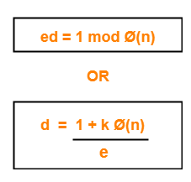
RSA Another Example
Two prime numbers, p=7, q=17
Calculate n = pq = 7 * 17 = 119
Φ(n) = (p-1)(q-1) = 96
Select e such that e is relatively prime to 96 and less than Φ(n), suppose e = 5
d=77 because 77*5= 385= 4*96+1
d=77 because (1.96-19.5=1 )mod 96
Public Key KU={5,119)
Private Key KR={77,119}
Say plaintext M = 19
C=19⁵(mod 119) = 66
Decryption: M=66⁷⁷(mod 119) = 19
Notes:
53

Slide 54
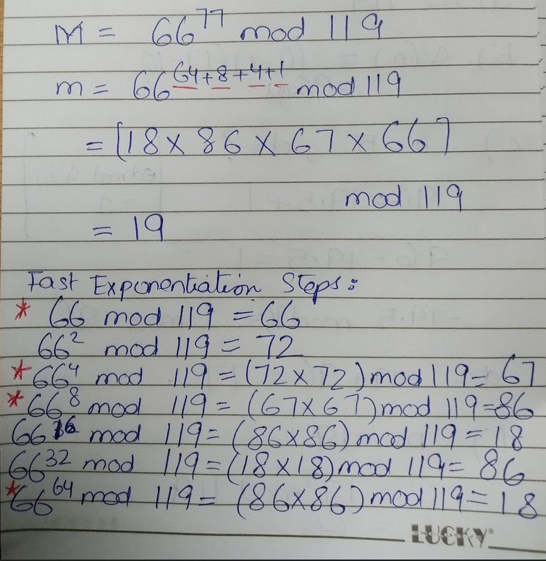
RSA Another Example
Notes:
54

Slide 55
Security of RSA
The problem of factoring n into two prime factors is computationally very difficult
Because n = p * q where p and q are at least 600 digit numbers(2048 bit), product is even bigger.
φ(n) cannot be computed without factoring n
As φ(n) is not known e and d are not known either.
Cipher remains unbreakable
Notes:
55

Slide 56
Security of RSA
Eve knows the public key (e, n) of Bob and wants to know his private key (d, n) so she can decrypt messages sent to Bob
To calculate d, she has to solve the equation: d = e⁻¹ (mod (p-1)(q-1))
However, this means that she needs to know the prime numbers p and q
She knows that n is the product of p and q, so she can recover p and q if she can factor n into its component prime numbers
Factoring large integers (over 250 digits) is known to be a difficult problem in mathematics and computer science and provided that the prime factors of n are sufficiently large, it would be computationally infeasible for Eve to calculate p and q (and hence d) from Bob’s public key

Slide 57
RSA implementation issues
The RSA algorithm requires working with very large integers (e.g., over 500 bits)
However, most computers have a much smaller word size, which represents the largest integer that can be stored in a CPU register (e.g., 32 bits)
The mathematical operations supported by most compilers and high-level languages is usually restricted to the word size of the CPU, so to implement RSA we need to know how to efficiently perform modular multiplication and exponentiation

Slide 58
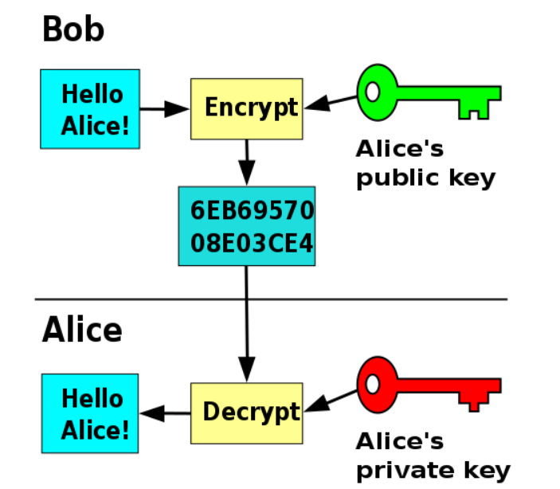
Encryption
Notes:
58

Slide 59
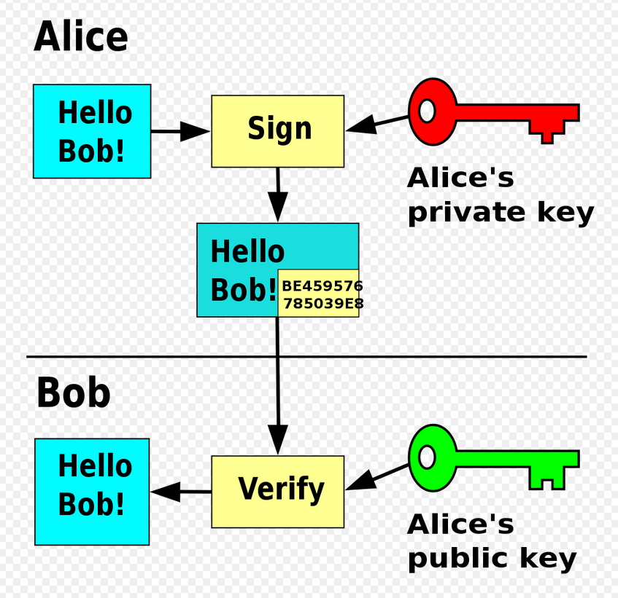
Digital Signature
Notes:
59

Slide 60
Kerckhoffs Principles System + Keys August Kerckhoffs, Journal of Military Science, 1883
The system must be substantially, if not mathematically, undecipherable;
The system must not require secrecy and can be stolen by the enemy without causing trouble;
It must be easy to communicate and remember the keys without requiring written notes, it must also be easy to change or modify the keys with different participants;
The system ought to be compatible with telegraph communication;
The system must be portable, and its use must not require more than one person;
Finally, regarding the circumstances in which such system is applied, it must be easy to use and must neither require stress of mind nor the knowledge of a long series of rules.
Notes:
60

Slide 61
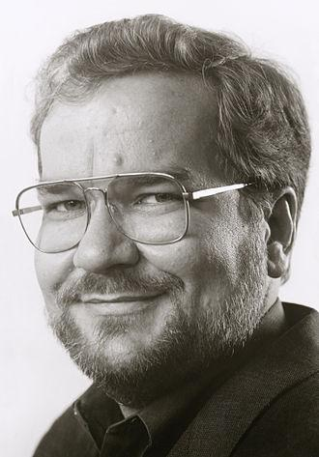
The Story of Phil Zimmerman & Pretty Good Privacy
Military Value
Commercial + Personal Applications
Encryption Debate
Key Escrow
"The natural flow of technology tends to move in the direction of making surveillance easier", and "the ability of computers to track us doubles every eighteen months", in reference to Moore's law.

Slide 62
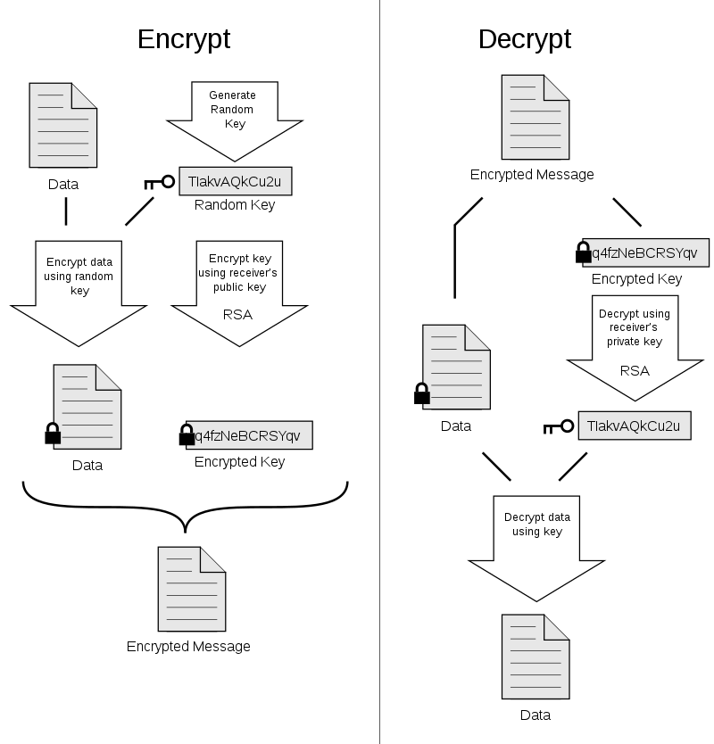
Pretty Good Privacy

Slide 63
Any Questions ?

